Slide 1
Chapter 7: Modifiability

Slide 2
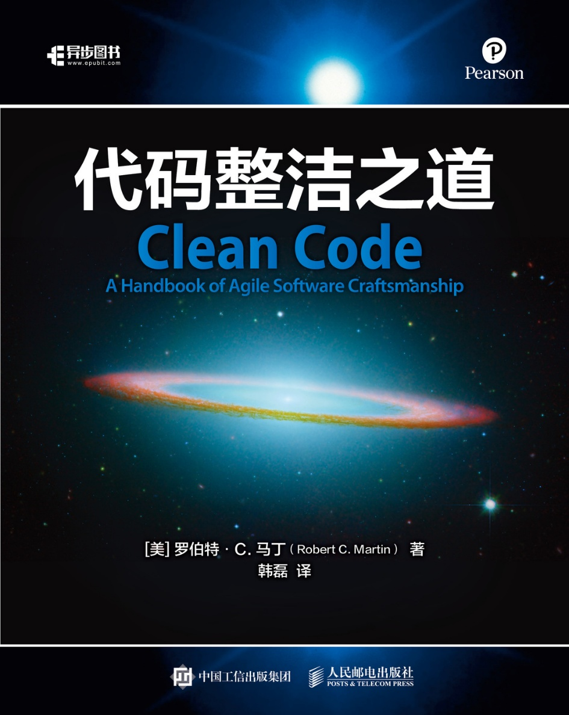
写代码要像写诗一样

Slide 3
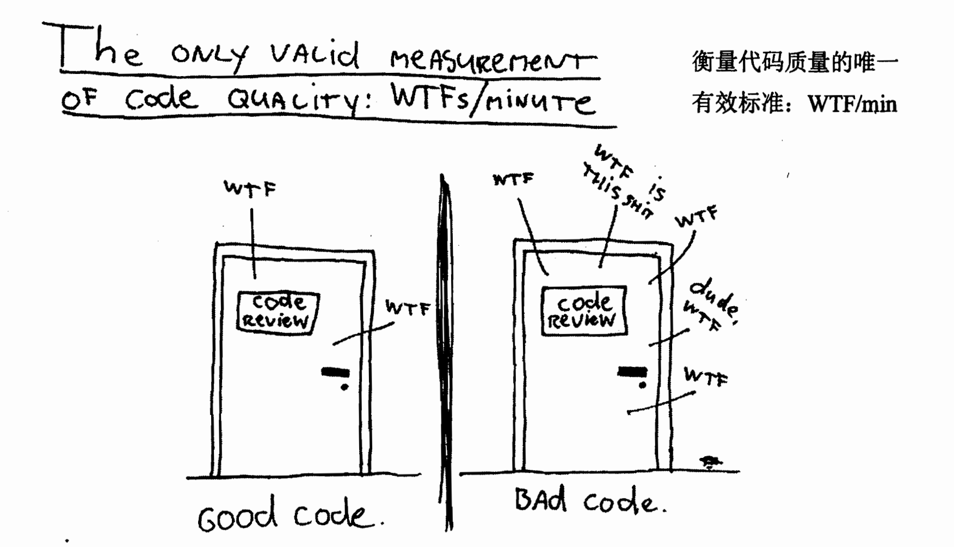

Slide 4
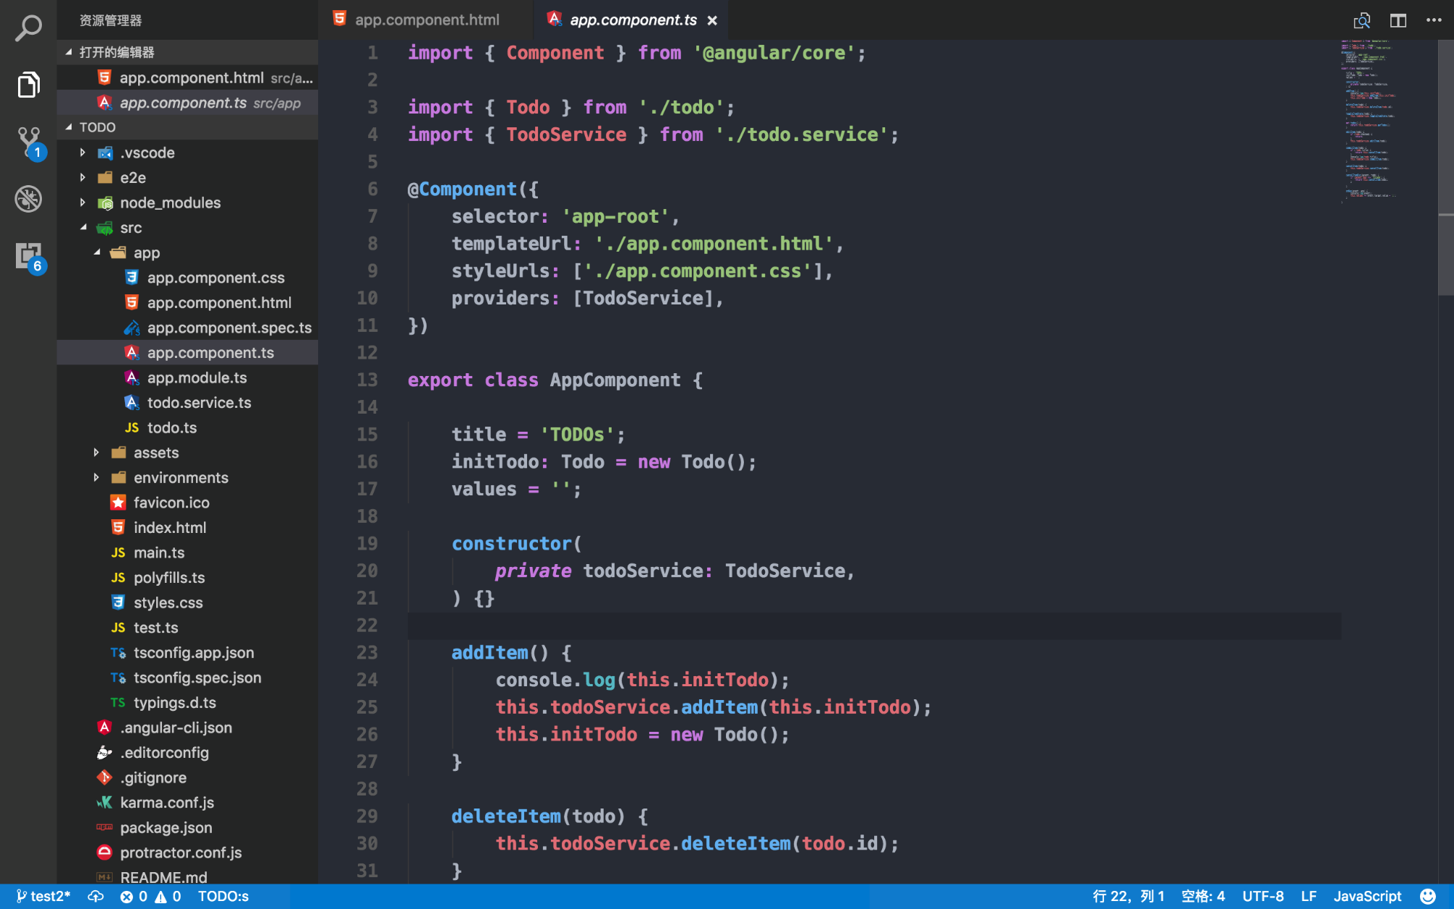


Slide 5
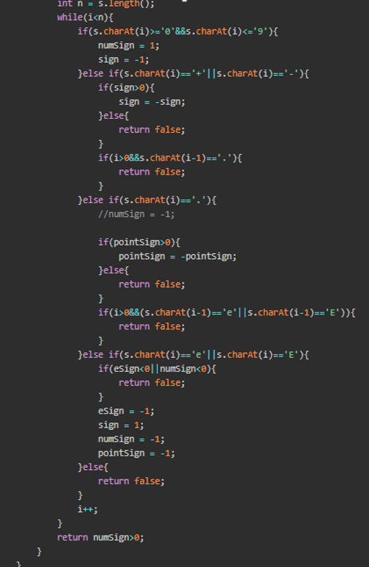

Slide 6


Slide 7


Slide 8
What is Modifiability?
Modifiability is about change and our interest in it is in the cost and risk of making changes.
To plan for modifiability, an architect has to consider four questions:
  What can change?
  What is the likelihood of the change?
  When is the change made and who makes it?
  What is the cost of the change?

Slide 9
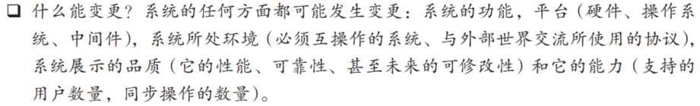
What can change?
The functions of the system
The platforms, i.e., the hardware, operating system, middleware
The environment in which the system operates
  The systems with which it must interoperate
  The protocols it use to communicate
The capacity
  Number of users supported
  Number of simultaneous operations

Slide 10
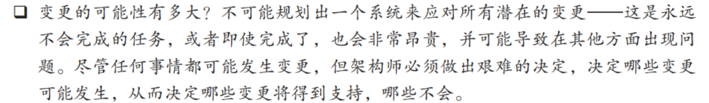
Probability of Change

Slide 11
When is the change made and who makes it?
Changes can be made during
  implementation by modifying the source code
  build by choice of libraries
  execution by parameter setting, plugins, etc
Changes can also be made by
  a developer
  an end user
  a system administrator

Slide 12
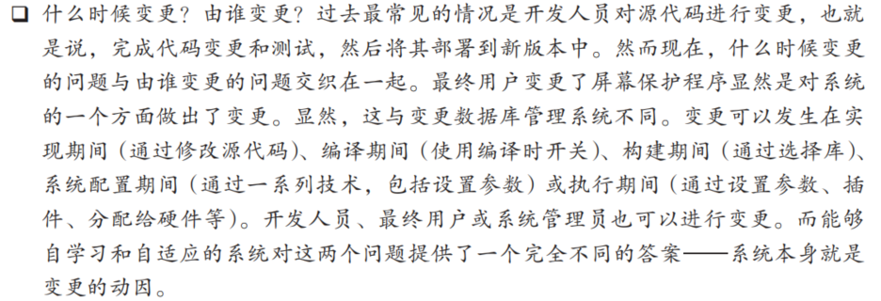
When is the change made and who makes it?

Slide 13
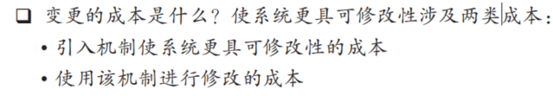
What is the cost of the change?
Involving two types of cost
  The cost of introducing the mechanisms to make the system more modifiable
    e.g. 最简单的变更机制是等待变更请求进来，然后变更源代码以适应该请求, cost = 0
  The cost of making the modification using the mechanisms
    e.g. cost -> max
It might be cheaper in the long run to build a sophisticated change-handling mechanism

Slide 14
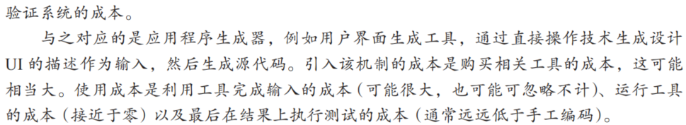
What is the cost of the change?

Slide 15
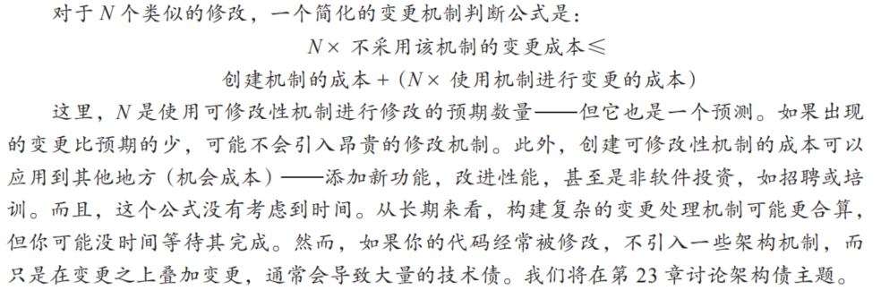
What is the cost of the change?

Slide 16
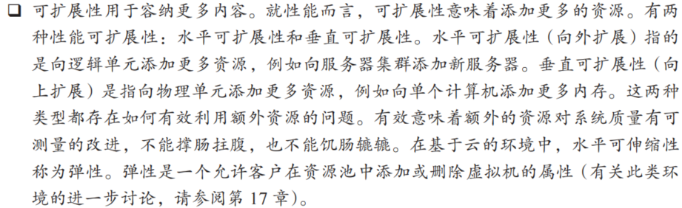
Specific Types of Changes

Slide 17
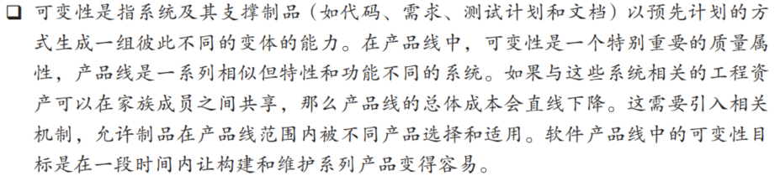
Specific Types of Changes

Slide 18
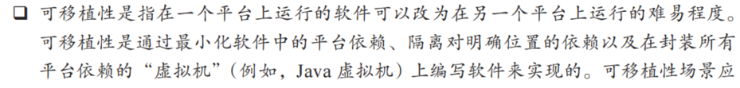
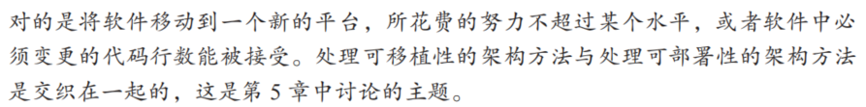
Specific Types of Changes

Slide 19
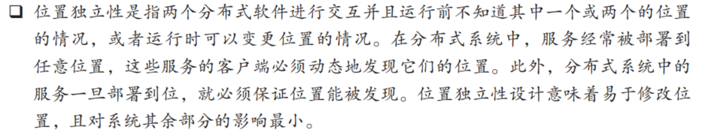
Specific Types of Changes

Slide 20
Modifiability General Scenario
Portion of Scenario | Possible Values
Source | End user, developer, system administrator
Stimulus | A directive to add/delete/modify functionality, or change a quality attribute, capacity, or technology
Artifacts | Code, data, interfaces, components, resources, configurations, …
Environment | Runtime, compile time, build time, initiation time, design time
Response | One or more of the following: make modification test modification deploy modification
Response Measure | Cost in terms of: number, size, complexity of affected artifacts effort calendar time money (direct outlay or opportunity cost) extent to which this modification affects other functions or quality attributes new defects introduced

Slide 21
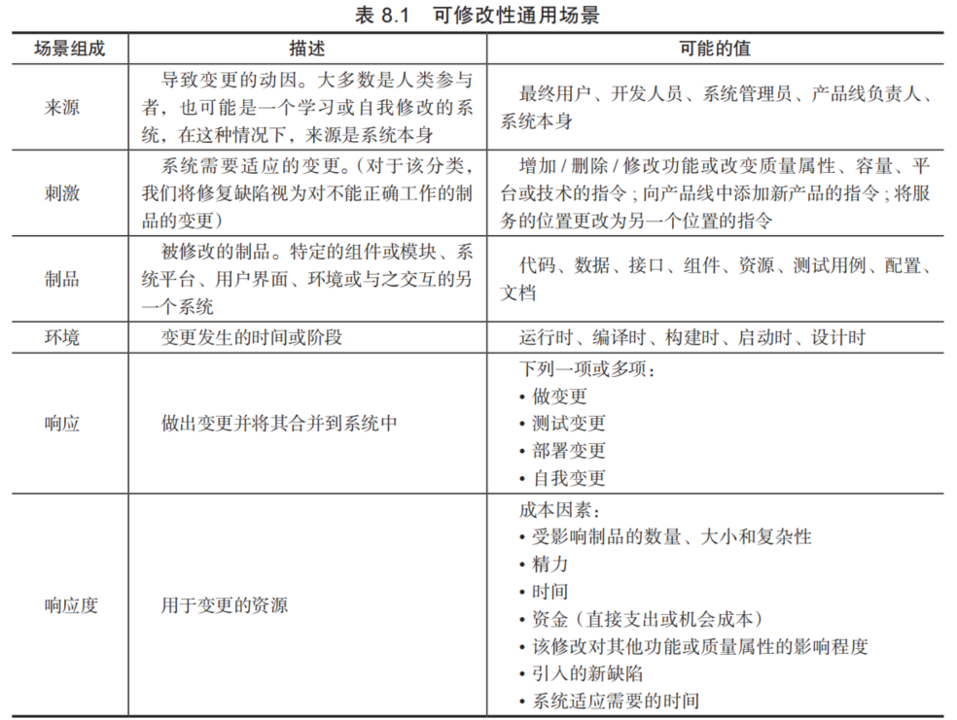
Modifiability General Scenario

Slide 22
Sample Concrete Modifiability Scenario
The developer wishes to change the user interface by modifying the code at design time. The modifications are made with no side effects within three hours.
  Stimulus – Wishes to change UI
  Artifact – Code
  Environment: Design time
  Response – Change made
  Response measure – No side effects in three hours
  Source - Developer

Slide 23
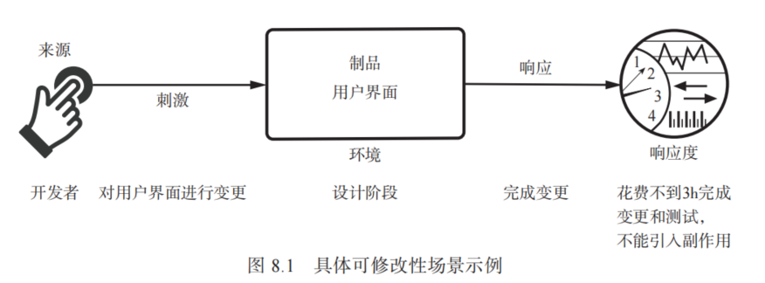
Sample Concrete Modifiability Scenario

Slide 24
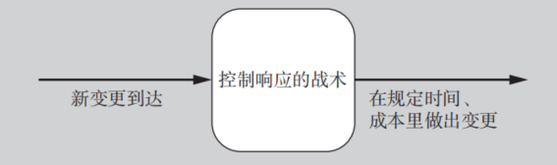
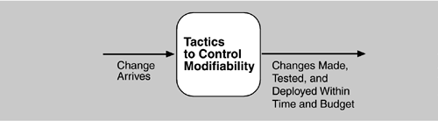
Goal of Modifiability Tactics
Goal of modifiability
  controlling the complexity of making changes,
  controlling the time and cost to make changes.

Slide 25
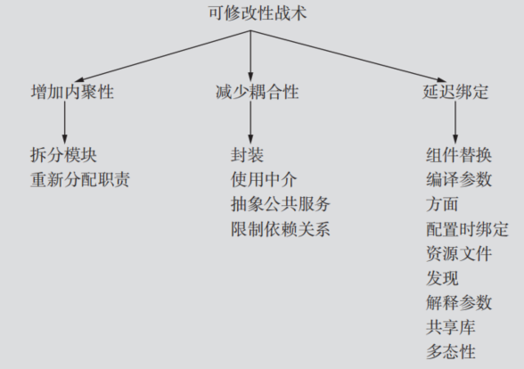
Modifiability Tactics

Slide 26
高内聚、低耦合
内聚(Cohesion)用于度量一个模块的职责之间的关系有多紧密。非正式地，它衡量模块的“目标一致性”。
Coupling is measured by this overlap, i.e., by the probability that a modification to one module will propagate to the other
  如果两个模块的职责以某种方式重叠，那么对其中一个进行变更可能会影响到另一个

Slide 27
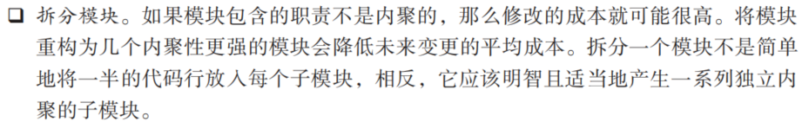
增加内聚（Increase Cohesion）
Split Module: If the module being modified includes a great deal of capability, the modification costs will likely be high.
Refining the module into several smaller modules should reduce the average cost of future changes.

Slide 28
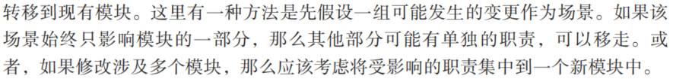
增加内聚（Increase Cohesion）
Reassign responsibilities. If (similar) responsibilities A, A′, and A′′ are scattered across several different modules, it's best to bring them together. This kind of refactoring may involve creating a new module or moving the responsibilities into an existing one. responsibilities into a new module.

Slide 29
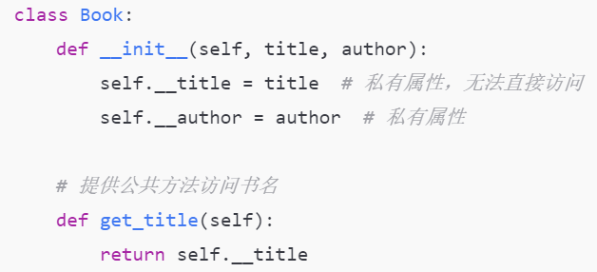
减少耦合 (Reducing Coupling)
Encapsulate（封装）: Encapsulation introduces an explicit interface to a module. This interface includes an API and its associated responsibilities

Slide 30
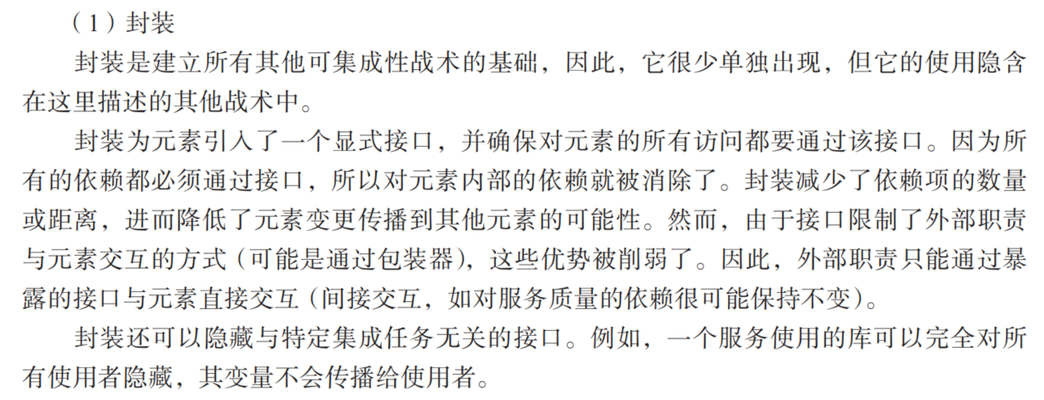
减少耦合 (Reducing Coupling)

Slide 31
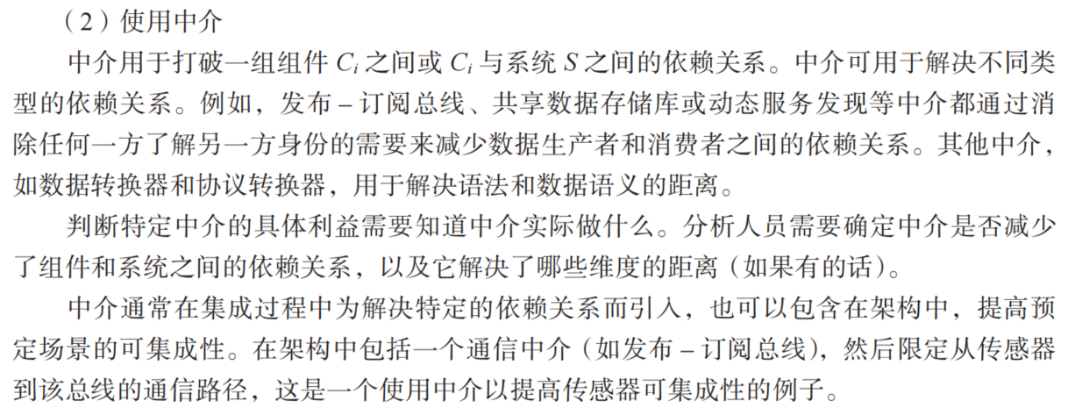
减少耦合 (Reducing Coupling)
Use an Intermediary: Given a dependency between responsibility A and responsibility B (for example, carrying out A first requires carrying out B), the dependency can be broken by using an intermediary.

Slide 32
减少耦合 (Reducing Coupling)
Restrict Dependencies: restricts the modules which a given module interacts with or depends on.
By restricting a module’s visibility and by authorization
For example,
  a layer is allowed to see the modules in its bottom layer (layered module)

Slide 33
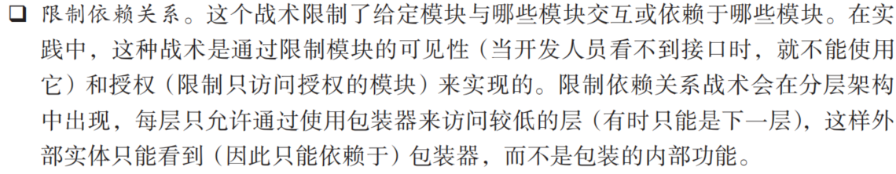
减少耦合 (Reducing Coupling)
Restrict Dependencies: restricts the modules which a given module interacts with or depends on.
By restricting a module’s visibility and by authorization. For example, a layer is allowed to see the modules in its bottom layer (layered module)

Slide 34
减少耦合 (Reducing Coupling)
Abstract Common Services: where two modules provide not-quite-the-same but similar services, it may be cost-effective to implement the services just once in a more general (abstract) form.

Slide 35
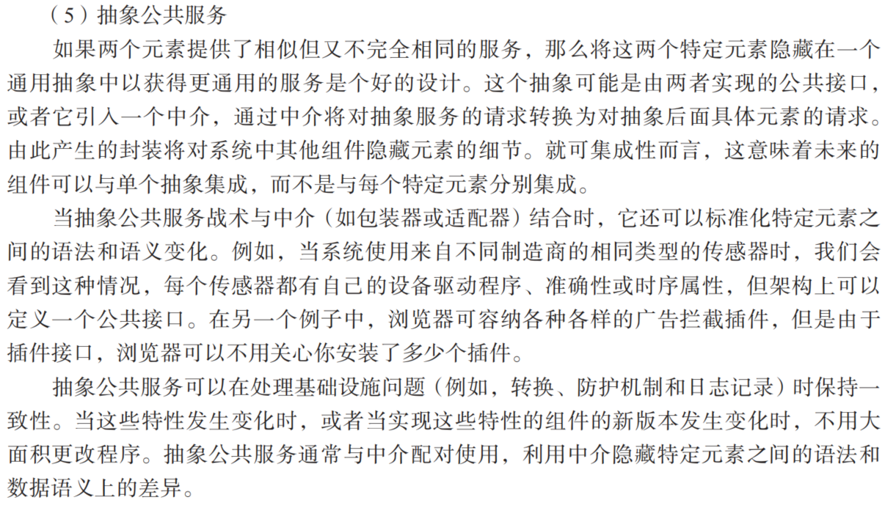
减少耦合 (Reducing Coupling)

Slide 36
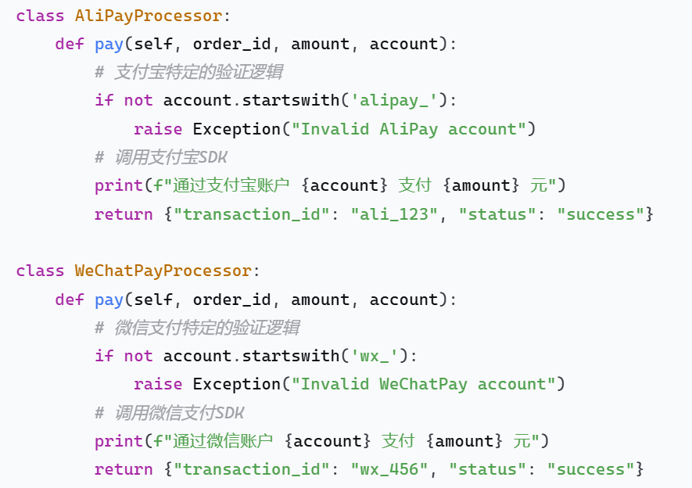
抽象前
都有pay这个函数、功能

Slide 37
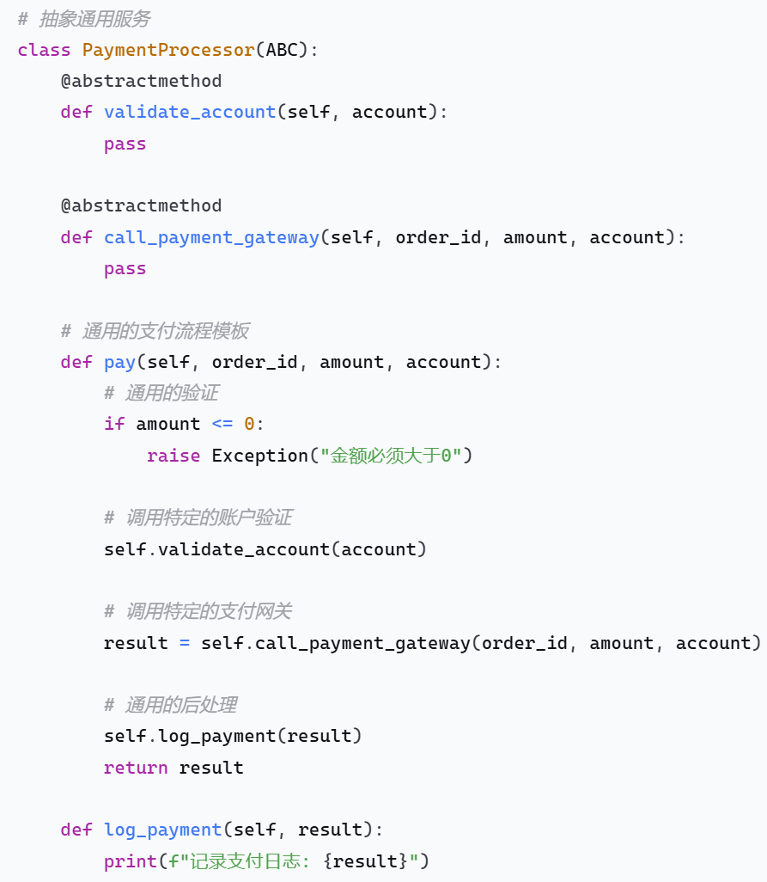
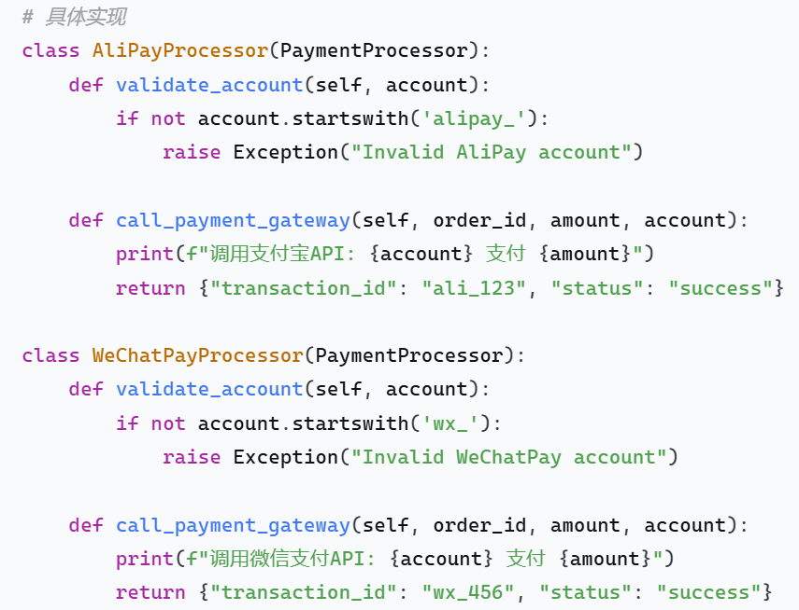
抽象后
通用逻辑（金额验证、日志记录）只写一次
添加新的支付方式（如Apple Pay）只需要实现特定的验证和网关调用
支付流程的变更只需要修改基类

Slide 38
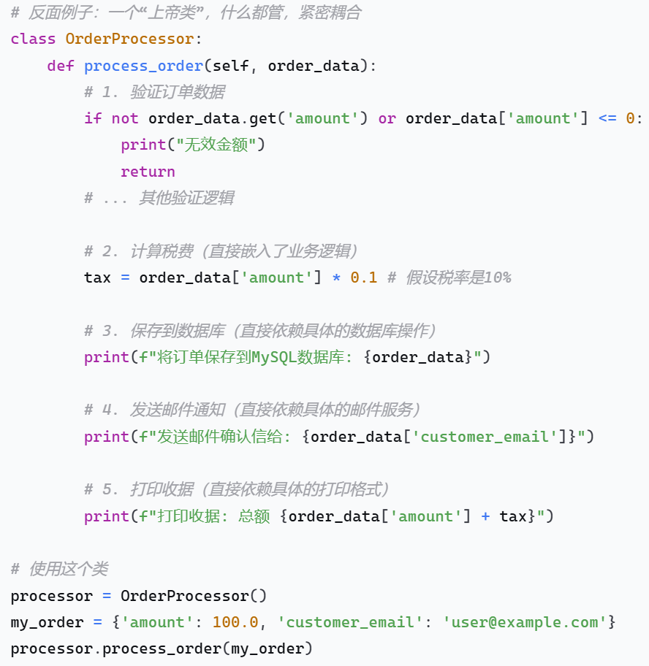
负面例子

Slide 39
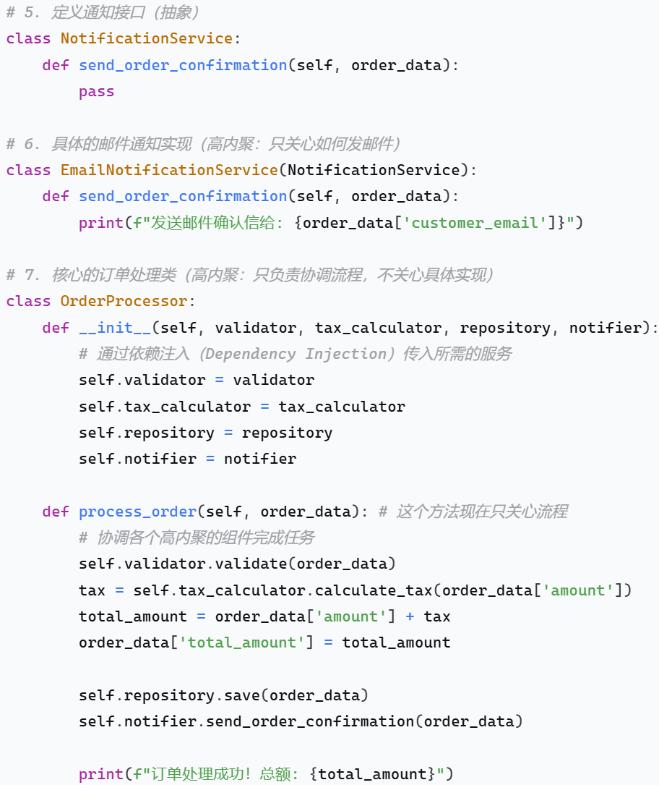
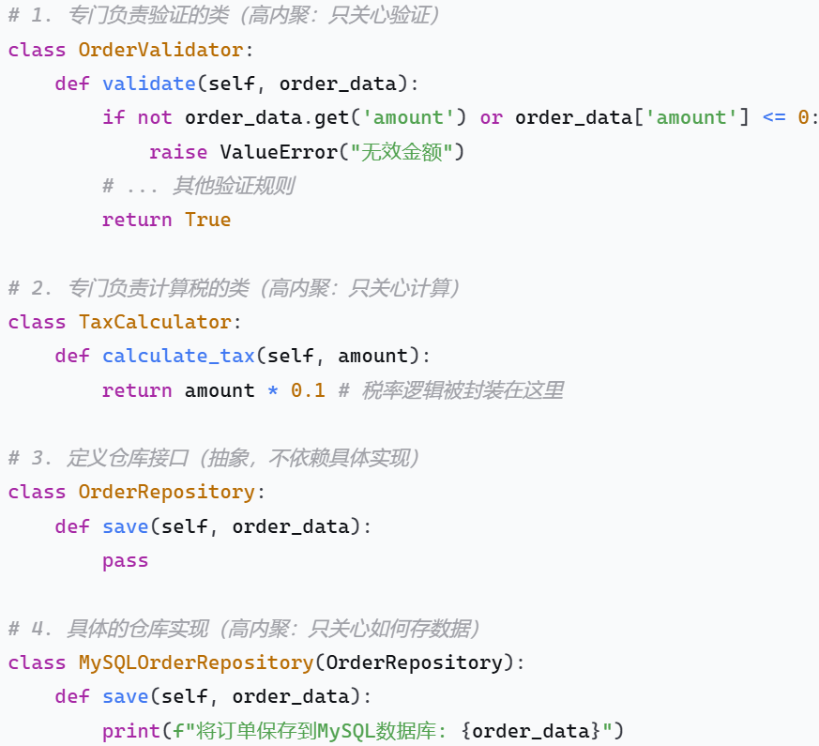
正面例子

Slide 40
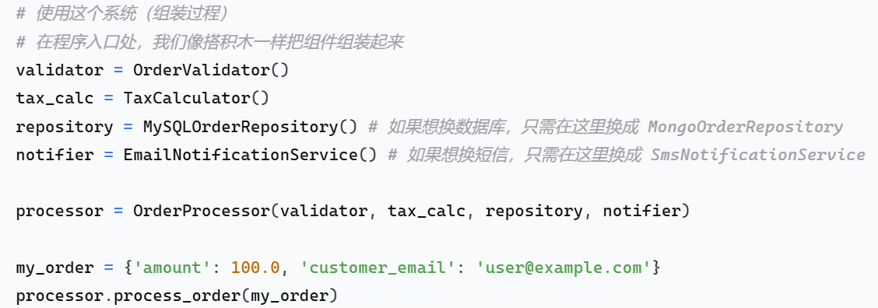

Slide 41
Defer Binding
In general, the later in the life cycle we can bind values, the better.
If we design artifacts with built-in flexibility, then exercising that flexibility is usually cheaper than hand-coding a specific change.
However, putting the mechanisms in place to facilitate that late binding tends to be more expensive.

Slide 42
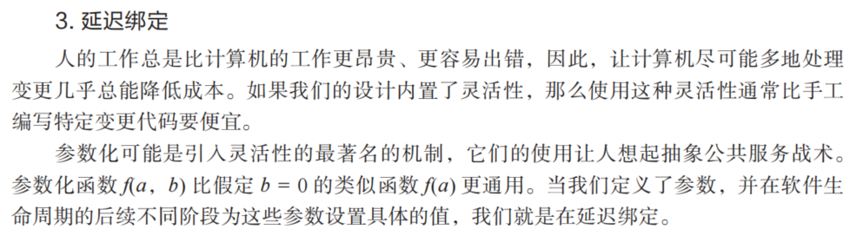
Defer Binding
不要写死

Slide 43
Publish/Subscribe System

Slide 44
Introduction:
Motivations for Pub/Sub model
Traditional Client/Server communication model
  (Employs RPC, message queue etc..)
  Synchronous, tightly-coupled request invocations.
    两个都得一起改
  Very restrictive for distributed applications, especially for WAN and mobile environments.
  When nodes/links fail, system is affected. Fault Tolerance must be built in to support this.
Require a more flexible and de-coupled communication style that offers asynchronous mechanisms.

Slide 45
What is a Publish/Subscribe System?
Pub/Sub System is a communication paradigm that allows freedom in the (distributed) system by the decoupling of communication entities in terms of time, space and synchronization.
  增删订阅者
  加删新功能
  发布者/订阅者只关注消息的生成/处理
  e.g. 社交媒体/公众号/天气通知
An event service system that is asynchronous, anonymous and loosely-coupled.
Ability to quickly adapt in a dynamic environment.

Slide 46
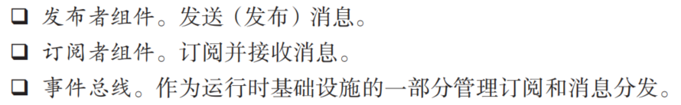
Key components of Pub/Sub System
Publishers : Publishers generate event data and publishes them.
Subscribers : Subscribers submit their subscriptions and process the events received
P/S service: It’s the mediator/broker that filters and routes events from publishers to interested subscribers.

Slide 47
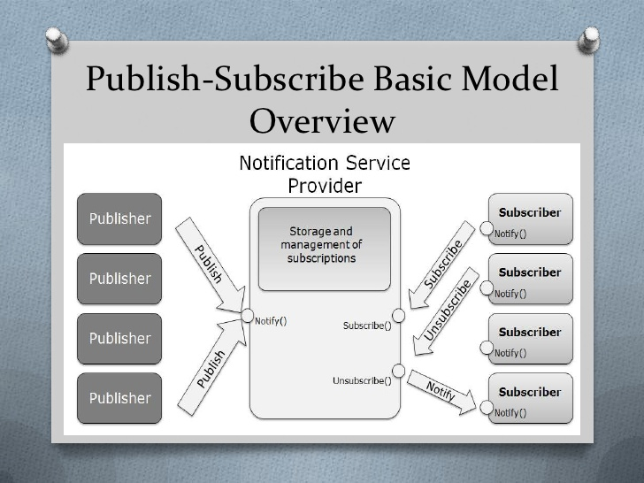
Publish/Subscribe System

Slide 48
Example: Weather
(Traditional Client/Server Model)
How It Works:
The user’s device (client) sends a request to the weather service’s server, usually using RPC (Remote Procedure Call).
The server processes the request and sends back the current weather information.
Characteristics:
Tight Coupling: The client and server are directly dependent on each other. The client needs to know the server's interface to request weather data correctly.
Synchronous Requests: Every time the user wants an update, the client must manually request it from the server and wait for a response. If the server is slow, the user experience suffers.
Problems:
Delayed Information: Users have to keep asking for updates, which might lead them to miss important information (like sudden weather changes).
Load Issues: During high demand, the server may face many requests, causing performance problems.
Poor Scalability: Adding new features (like personalized weather alerts) might require changes to both the client and server code, increasing maintenance costs.

Slide 49
Example: Weather
(Publish/Subscribe)
How It Works:
Users subscribe to weather updates for specific areas. When the weather changes, the service publishes the information to all subscribers.
Users receive new weather information without having to request it manually.
Characteristics:
Loose Coupling: The publisher (weather service) and subscribers (user devices) are not directly dependent on each other. Users just need to subscribe to the information they want, and the weather service doesn’t need to know the details of each user.
Asynchronous Notifications: The weather service actively pushes notifications when information changes, allowing users to receive updates in real-time without waiting.
Advantages:
Instant Updates: Users get timely alerts for sudden weather changes, improving their experience.
Balanced System Load: The server sends out information during weather changes, reducing the request burden on users.
Easy to Expand: New features, like multi-area subscriptions or personalized alerts, can be added easily without major changes to existing code.

Slide 50
Publish-Subscribe vs UDDI
特性 | 发布-订阅模式 (Publish-Subscribe) | UDDI (Universal Description, Discovery, and Integration)
核心目的 | 解耦消息的发送者（发布者）和接收者（订阅者），实现事件的实时、异步广播。 | 存储和发现可用的服务。让服务消费者能找到他们想调用的服务提供者。
要解决的问题 | 组件之间直接依赖、紧耦合。发布者不需要知道谁订阅了消息，订阅者也不需要知道消息来自哪里。 | 服务位置透明性。服务消费者不需要硬编码服务提供者的网络地址。
交互模式 | 一对多 (1:N) 或 多对多 (M:N)。一个事件可以被多个订阅者接收。 | 查询-响应 (Query-Response) 或 注册-查找 (Register-Lookup)。本质上是一对一的交互。
数据流 | 持续的、流动的“事件流”或“消息流”。数据是动态的，与时间相关。 | 相对静态的“服务描述信息”。数据是元数据，变化不频繁。
生命周期 | 短暂的。消息被消费后通常就不存在了（除非有持久化策略）。 | 长久的。服务注册信息会一直存在，直到服务被注销。
典型中间件 | 消息队列/消息代理，如：RabbitMQ, Apache Kafka, Redis Pub/Sub, MQTT Broker。 | 服务注册中心，如：UDDI Registry, Consul, Nacos, Eureka。
一个经典的问与答 | 问：发生了什么事件？ 答： 有订单创建了！（这是一个事件消息） | 问： 谁能处理‘创建订单’这个操作？ 答： 在 192.168.1.10:8080 的‘订单服务’可以。（这是一个服务地址）

Slide 51
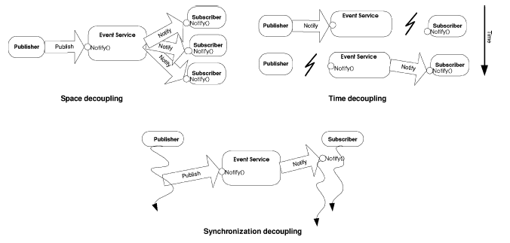
Decoupling in time, space and synchronization
Provides decoupling in time, space and synchronization.

Slide 52
Decoupling in time, space and synchronization
Spatial Decoupling
Spatial decoupling means that publishers and subscribers do not need to know about each other. An intermediary service manages the communication between them, reducing direct dependencies.
Temporal Decoupling
Temporal decoupling allows publishers and subscribers to not be active at the same time. A publisher can stop running after sending a message, and the subscriber will still receive it, as long as the intermediary has received and forwarded the message. This increases flexibility in how components operate.
Synchronization Decoupling
Synchronization decoupling ensures that publishers are not blocked while producing events, and subscribers can be notified of events asynchronously while performing other tasks. This enhances the system's concurrency and responsiveness.

Slide 53
Classification of Pub/Sub Architectures
Centralized Broker model
  Consists of multiple publishers and multiple subscribers and centralized broker/brokers (an overlay network of brokers interacting with each other).
  Subscribers/Publishers will contact 1 broker, and does not need to have knowledge about others.
  E.g. CORBA (Common Object Request Broker Architecture) event services, JMS (Java Message Service) etc…

Slide 54
Classification of Pub/Sub Architectures
Peer-to-Peer model
  Each node can be publisher, subscriber or broker.
  Subscribers subscribe to publishers directly and publishers notify subscribers directly. Therefore they must maintain knowledge of each other.
  Complex in nature, mechanisms such as DHT and CHORD are employed to locate nodes in the network.
  E.g. Java distributed event service
  E.g. BitTorrent: In file-sharing applications, peers share pieces of files with each other, acting as both publishers (uploading pieces) and subscribers (downloading pieces).

Slide 55
Key Functions Implemented by P/S
Middleware Service
Event filtering (event selection)
  The process of selecting the set of subscribers that have shown interest in a given event.
  Subscriptions are stored in memory and searched when a publisher publishes a new event.
Event routing (event delivery)
  The process of routing the published events to all interested subscribers

Slide 56
Event Filtering (Subscription Model)
Topic based VS Content based
Topic based
  Generally also known as topic based, group based or channel based event filtering.
  Each event is published to one of these channels by its publisher.
  Subscribers subscribes to a particular channel and will receive ALL events published to the subscribed channel.

Slide 57
Topic-based subscription
Event filtering is easy. Simple process for matching an event to subscriptions.
Limited expressiveness

Slide 58
Event Filtering- Subscription Model
Topic based VS Content based
Content based
  More flexibility and power to subscribers, by allowing more expression in arbitrary/customized query over the contents of the event.
  Event publication by a key/value attribute pair, and subscriptions specify filters using a explicit subscription language.

Slide 59
Content-based Subscription
Added complexity in matching an event to subscriptions.
More precision is provided and event filtering/routing is easier

Slide 60
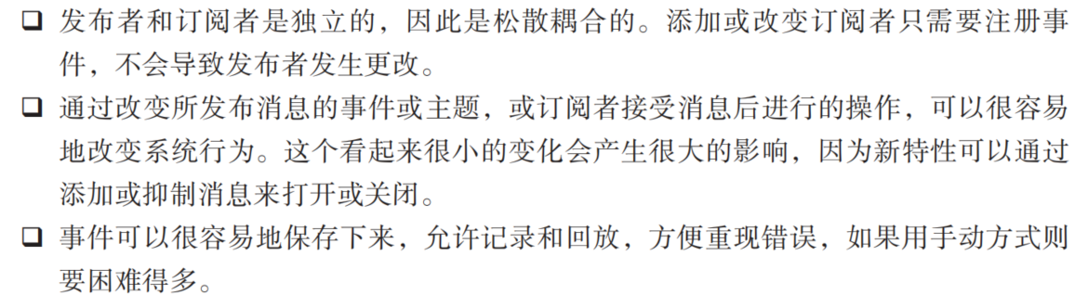
Advantages of Pub/Sub
Highly suited for mobile applications, ubiquitous computing and distributed embedded systems
Robust – Failure of publishers or subscribers does not bring down the entire system
Scalability- Suited to build distributed applications consisting a large number of entities
Adaptability- can be varied to suit different environments (mobile, internet game, embedded systems etc…)

Slide 61
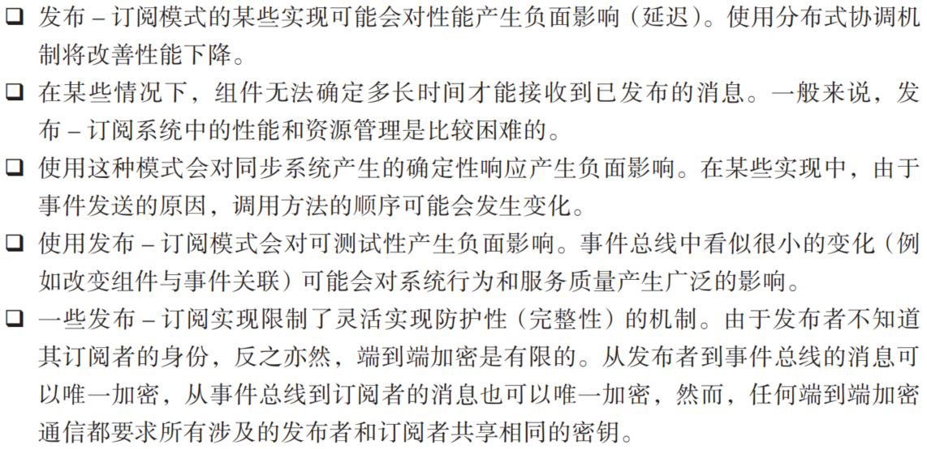
Disadvantages of Pub/Sub
Reliability – no strong guarantee on broker to deliver content to subscriber. After a publisher publishes the event, it assumes that all corresponding subscribers would receive it.
Potential bottleneck in brokers when subscribers and publishers overload them. (Solve by load balancing techniques)

Slide 62
Summary
Modifiability deals with change and the cost in time or money of making a change, including the extent to which this modification affects other functions or quality attributes.
Tactics to reduce the cost of making a change include making modules smaller, increasing cohesion, and reducing coupling.

